Slide 1
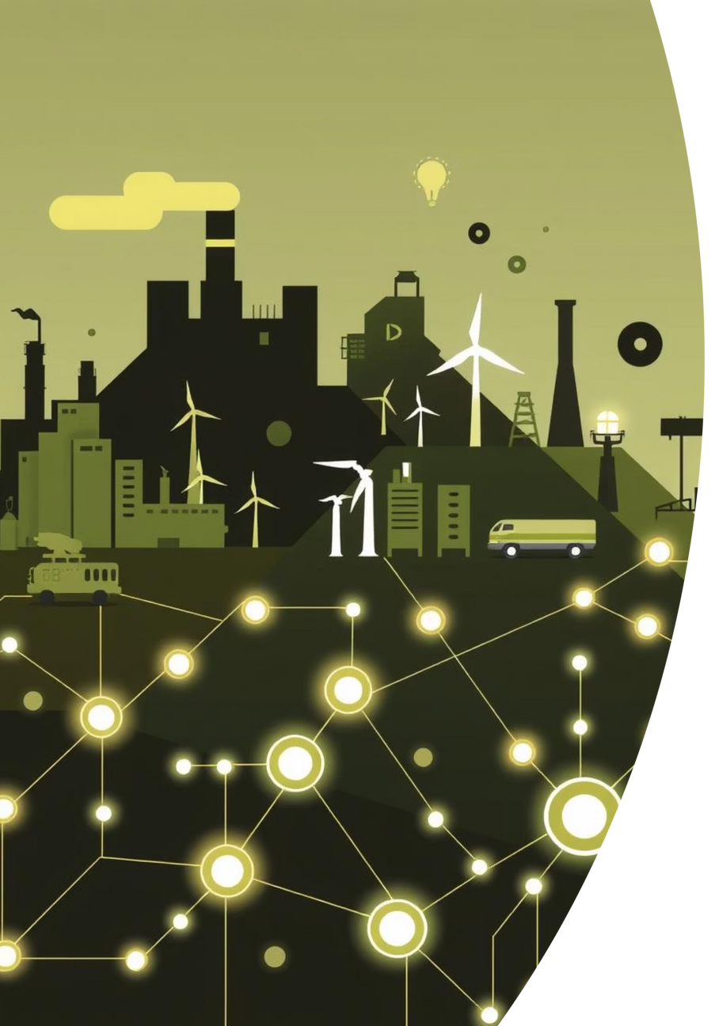
Applications of Data Science
Exploring real-world use cases across diverse industries.
by Desai Hardik
DH
Notes:
1

Slide 2
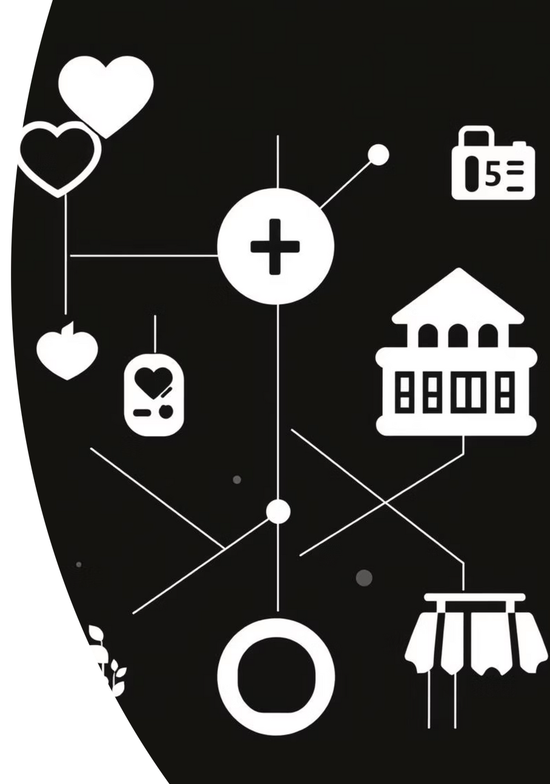

Agenda
1
Healthcare
Patient outcomes, drug discovery.
2
Finance
Fraud detection, risk assessment.
3
Retail
Customer behaviour, supply chain.
4
Other Sectors
Manufacturing, transport, media.
Notes:
2

Slide 3

Data Science in Healthcare
Improved Patient Outcomes
Predictive analytics for disease.
Personalised treatment plans.
Data science transforms healthcare, enhancing diagnostics and patient care.
Notes:
3

Slide 4
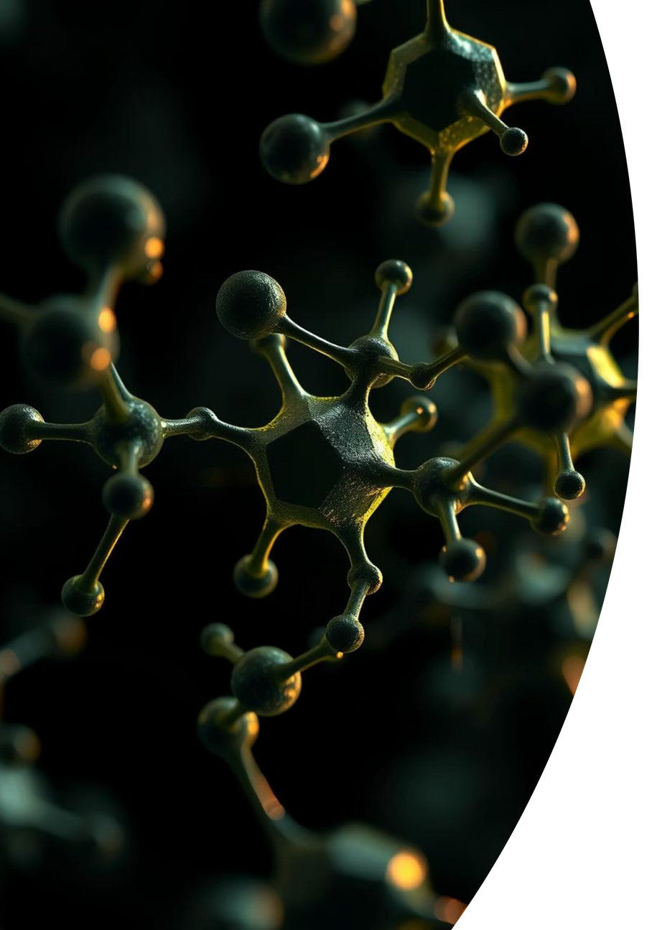
Drug Discovery & Development
Target Identification
AI identifies potential drug targets.
Compound Screening
Accelerated virtual screening.
Clinical Trials
Optimising trial design, patient selection.
Notes:
4

Slide 5

Data Science in Finance
Fraud Detection
Real-time anomaly detection.
Minimising financial losses.
Securing transactions and identifying suspicious activities.
Notes:
5

Slide 6
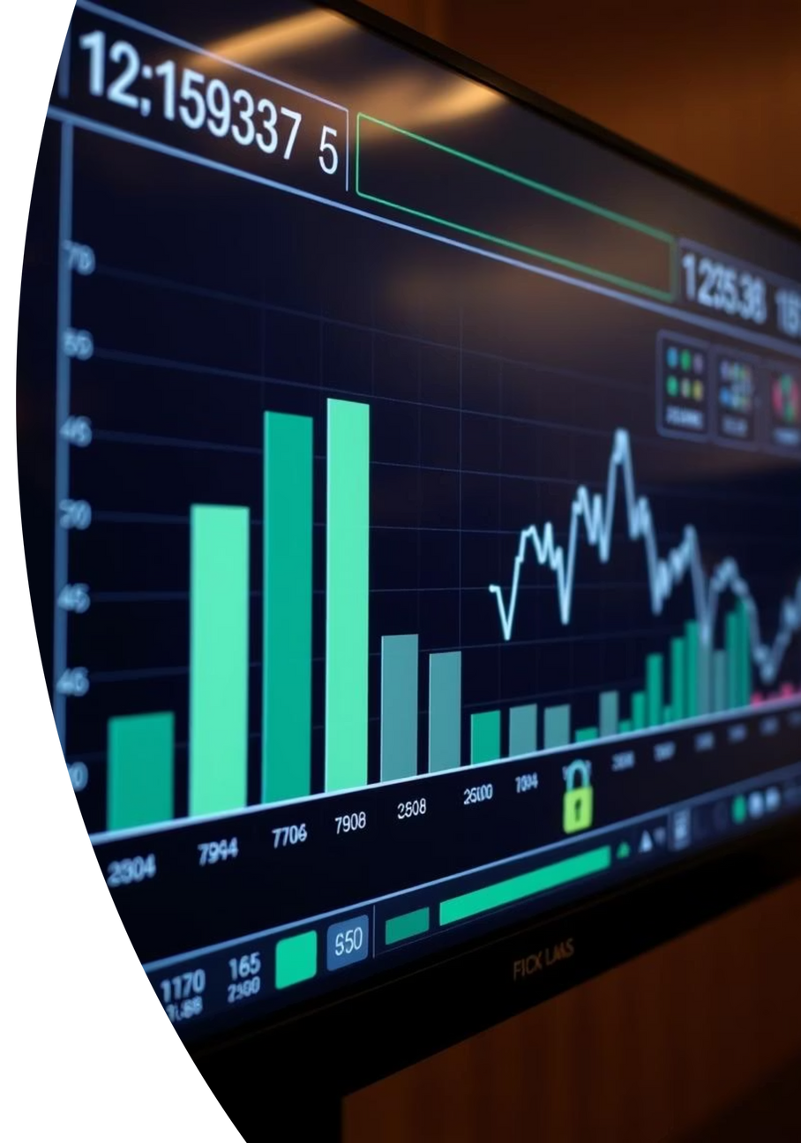



Risk Assessment & Trading
Market Prediction
Forecasting market trends.
Credit Scoring
Accurate credit risk models.
Algorithmic Trading
Automated, high-frequency trading.
Notes:
6

Slide 7
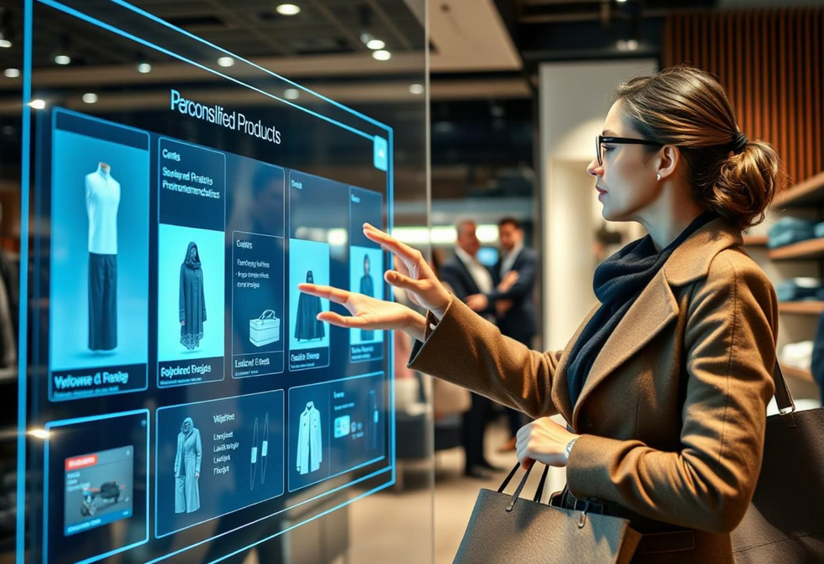
Data Science in Retail
Customer Behaviour
Personalised recommendations.
Targeted marketing campaigns.
Understanding shoppers for enhanced experiences.
Notes:
7

Slide 8

Key Takeaways & Future
Optimisation
Cost Reduction
AI optimises operations.
Significant cost savings.
Strategic Growth
Future-proofing businesses.
Notes:
8

